Slide 1
Biomarcadores emergentes em Carcinoma de pulmão não pequenas células
Ellen Caroline Toledo do Nascimento
Hospital das Clínicas e Instituto do Coração da Universidade de São Paulo
Rede D’or

Slide 2
Declaração de Conflito de Interesse
Dr(a). Ellen C. T. do Nascimento afirma ter potenciais conflitos
de interesse a declarar
Atividades educacionais: AstraZeneca, MSD, Daiichi Sankyo
Exigência da RDC Nº 96/08 da ANVISA

Slide 3
Declaração Conflitos de Interesse
De acordo com a Resolução 1931/2009 do Conselho Federal de Medicina e com a RDC 96/2008 da ANVISA, declaro que:
Apresentações: como palestrante convidado participo dos eventos:
Não possuo ações de quaisquer destas companhias farmacêuticas.
Os meus pré requisitos para participar destas atividades são a autonomia do pensamento científico, a independência de opiniões e a liberdade de expressão que estas empresas respeitam.

Slide 4
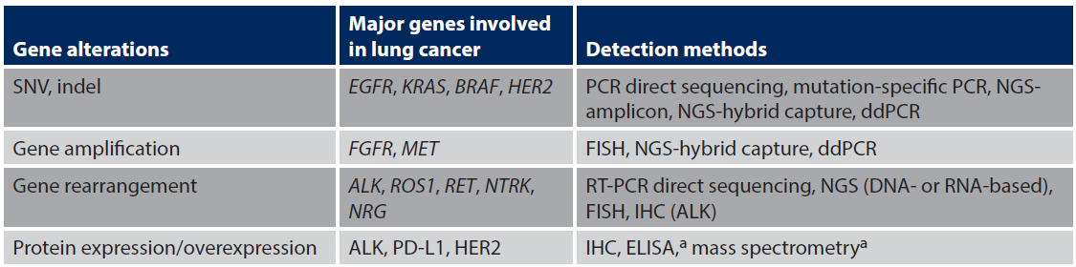
Métodos para detecção de biomarcadores
DNA (NGS, FISH, RT/PCR):
SNV (single nucleotide variant)
Deleções e inserções
Amplificação/variação no número de cópias
Rearranjos
RNA (NGS, ISH, RT/PCR):
Expressão gênica
Transcritos de fusão
Proteínas (IHQ, ELISA):
Expressão protéica
IASLC Atlas of Molecular Testing for Targeted Therapy in Lung Cancer, 2023.

Slide 5
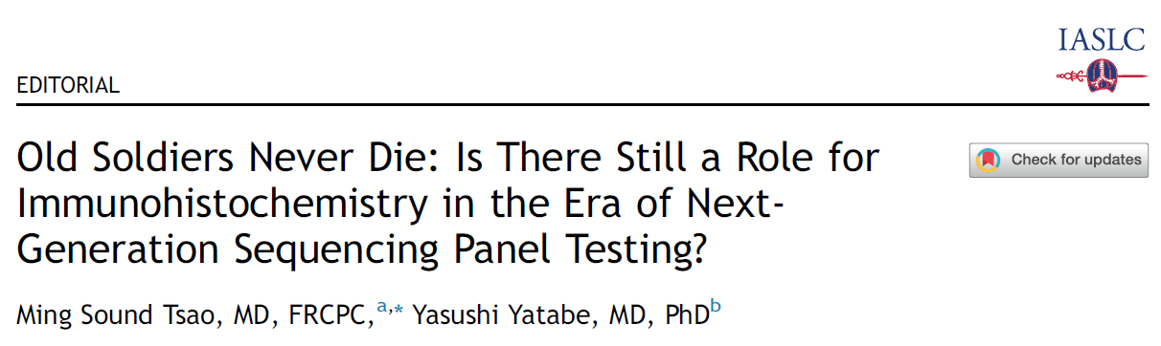
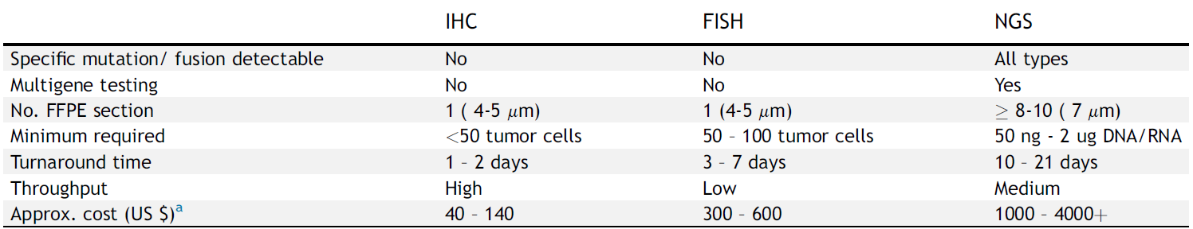
Tsao MS, Yatabe Y. J Thorac Oncol. 2019 Dec;14(12):2035-2038.
Pennell NA et al. JCO Precis Oncol. 2019 Dec;3:1-9.
Atherly AJ et al. Br J Cancer. 2012;106:1100–1106.
Hamblin A et al. PLoS Med. 2017;14:e1002230.
Romanus D et al. J Thorac Oncol. 2015;10:586–594.
Djalalov S et al. J Clin Oncol. 2014;32:1012–1019.
Notes:
However, NGS solo testing is akin to putting all eggs in one basket, as the risks of failure from obtaining results due to all reasons may range from 14% to 30% or higher.23-25 A major
component of this failure rate is insufficient tissue materials for sequencing, identified at the initial pathologic quality assessment step.
There are no perfect assays to detect gene alterations, thus, we should use all levels of gene products, considering advantages and disadvantages of the individual assays.

Slide 6
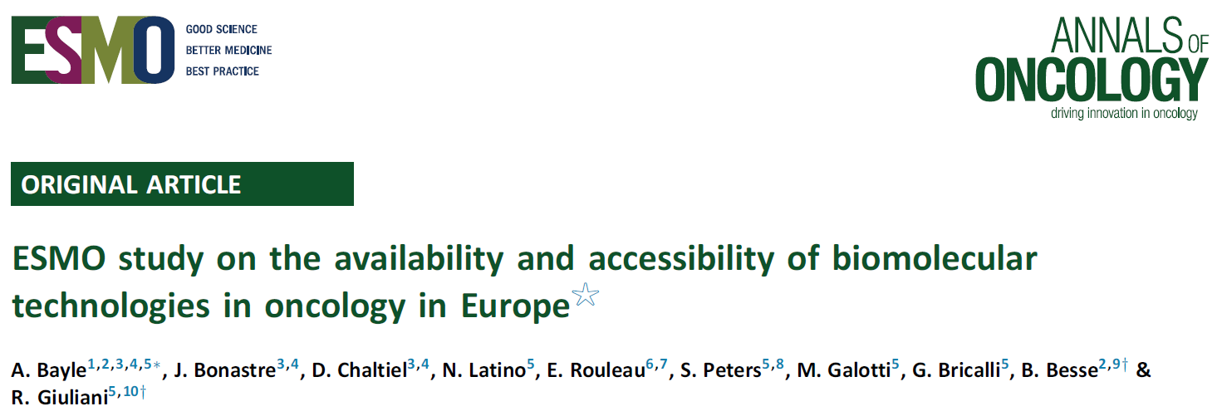
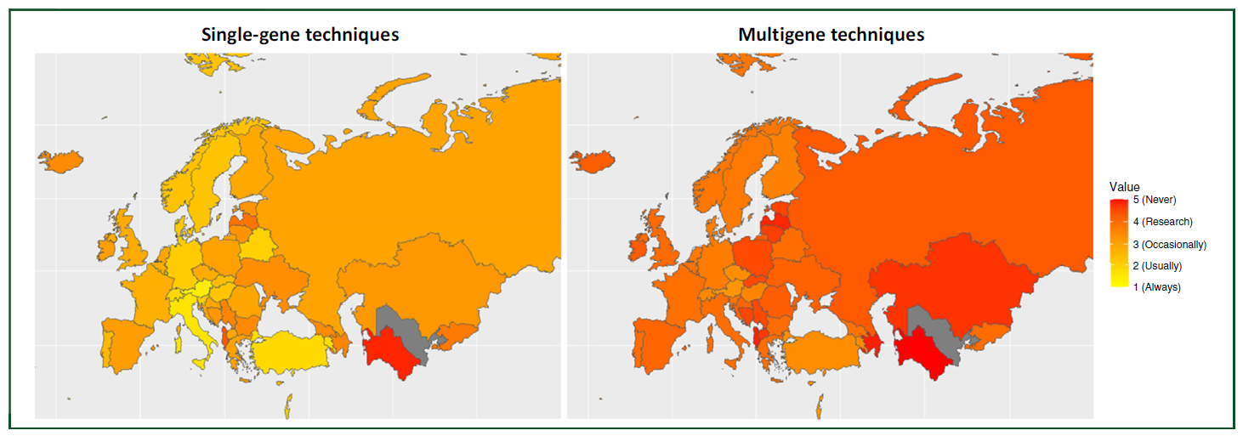
Bayle A et al. Ann Oncol. 2023 Oct;34(10):934-945.
Notes:
There are disparities across Europe in access to biomolecular technologies, which in turn limit patient access to targeted medicines. Even in high-income countries, large NGS panels
remain largely unavailable in routine practice, and are limited to clinical trials or research, preventing the search for additional biomarkers in daily practice even though targeted
therapies already exist. In the era of precision medicine, with the arrival of new targeted treatments requiring companion biomarkers, multiple gene testing diffusion is key to ensure equal access to cancer care in Europe.

Slide 7
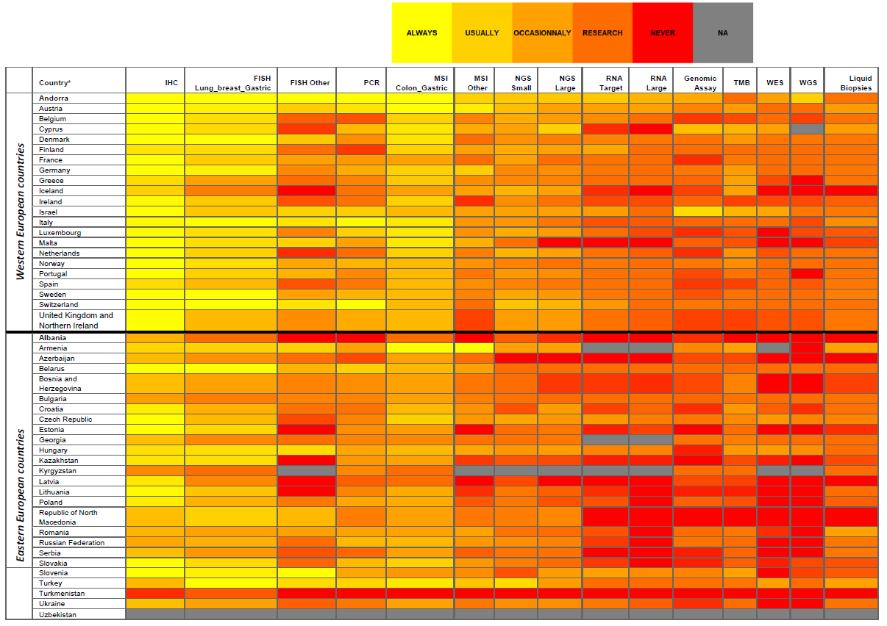
Bayle A et al. Ann Oncol. 2023 Oct;34(10):934-945.
Notes:
Our study shows that comprehensive NGS panels remain largely inaccessible in clinical routine practice and are limited to clinical and translational research, even in EU
countries, although disparities in access are more marked in lower-income Eastern European countries. Whereas single validated biomarkers assessed by simple techniques are
widely tested across countries, biomarkers requiring comprehensive panels are rarely tested outside clinical trials or clinical research.

Slide 8
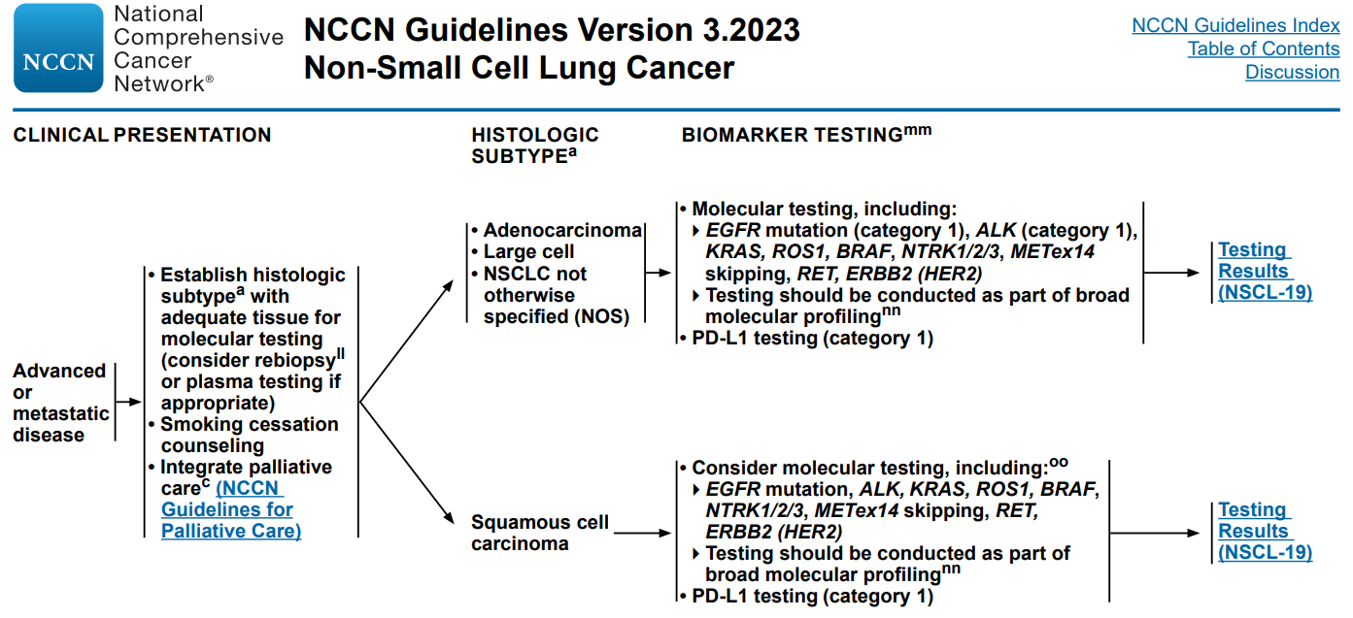
Version 3.2023, 2023 National Comprehensive Cancer Network® (NCCN®)
Notes:
The NCCN NSCLC Guidelines Panel strongly advises broader molecular profiling with the goal of identifying rare driver mutations for which effective drugs may already be available, or to appropriately counsel patients regarding the availability of clinical trials. Broad molecular profiling is defined as molecular testing that identifies all biomarkers identified in NSCL-19 in either a single assay or a combination of a limited number of assays, and optimally also identifies emerging biomarkers (NSCL-I). Tiered approaches based on low prevalence of co-occurring biomarkers are acceptable. Broad molecular profiling is a key component of the improvement of care of patients with N

Slide 9
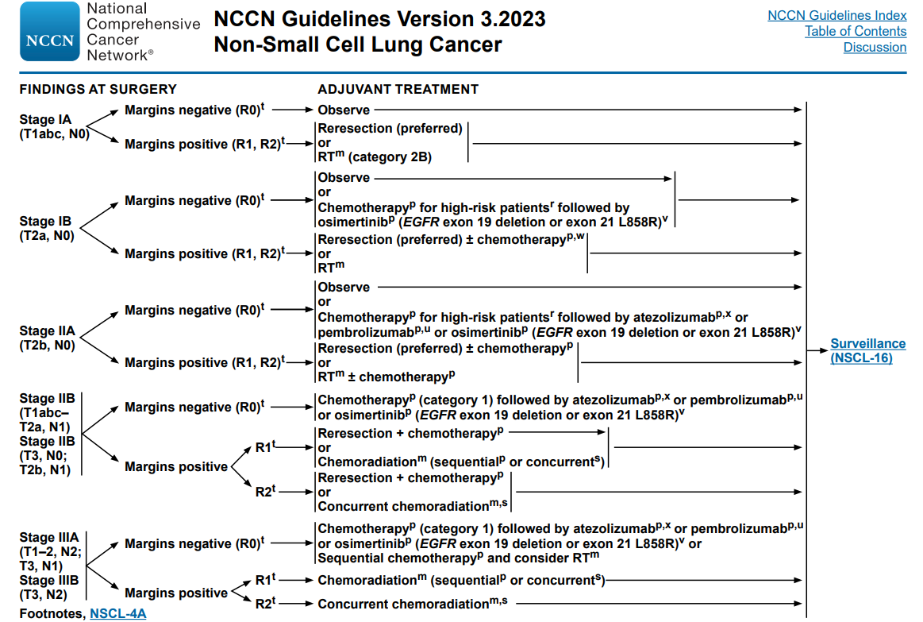
Version 3.2023, 2023 National Comprehensive Cancer Network® (NCCN®)

Slide 10
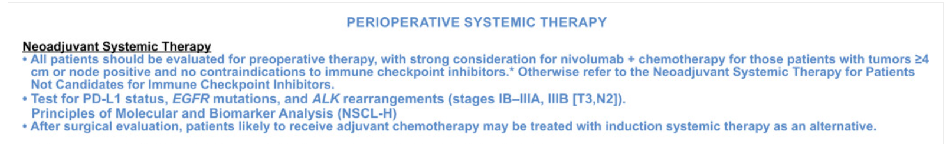
Aprovado pelo US Food and Drug Administration em 2022
Alguns “drivers” oncogênicos estão associados a menor benefício com inibidores de PD-1/PD-L1:
Deleções do exon 19 do gene EGFR.
Mutação L858R no exon 21 do gene EGFR.
Rearranjos do ALK.
Testes para PD-L1, mutações de EGFR e rearranjos do ALK são recomendados antes de administrar terapia neoadjuvante com Nivolumab + QT.
Evidências em paciente com ressecável NSCLC:
Regressão tumoral.
Resposta imune anti-tumoral de longa duração.
N Engl J Med 2022; 386:1973-1985.

Slide 11
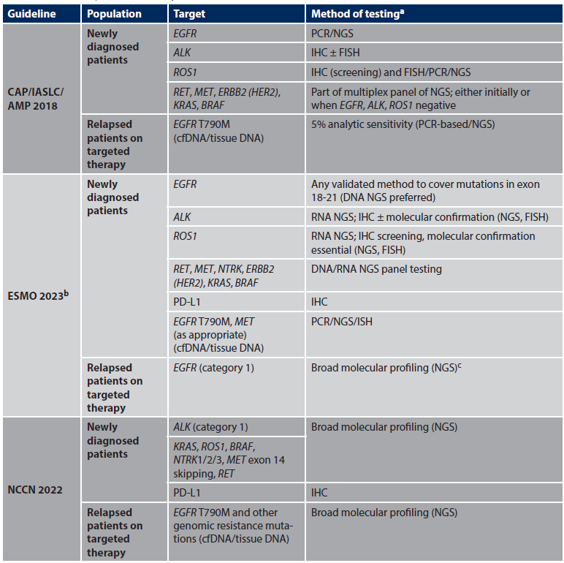
Sumário dos Guidelines (Europa e USA)
Adequado material para diagnóstico e testes moleculares
Subtipos histológicos específicos (reduzir a chance de CNPC SOE para menos de 10%)
Testes recomendados: EGFR, ALK, ROS-1, BRAF, NTRK, MET, RET, KRAS e HER-2.
Plataformas multiplex (NGS): preferência.
Não recomendado em CEC (apenas em casos pouco usuais).
IASLC Atlas of Molecular Testing for Targeted Therapy in Lung Cancer, 2023.
Hendriks LE, et al. Ann Oncol. 2023 Apr;34(4):339-357.

Slide 12
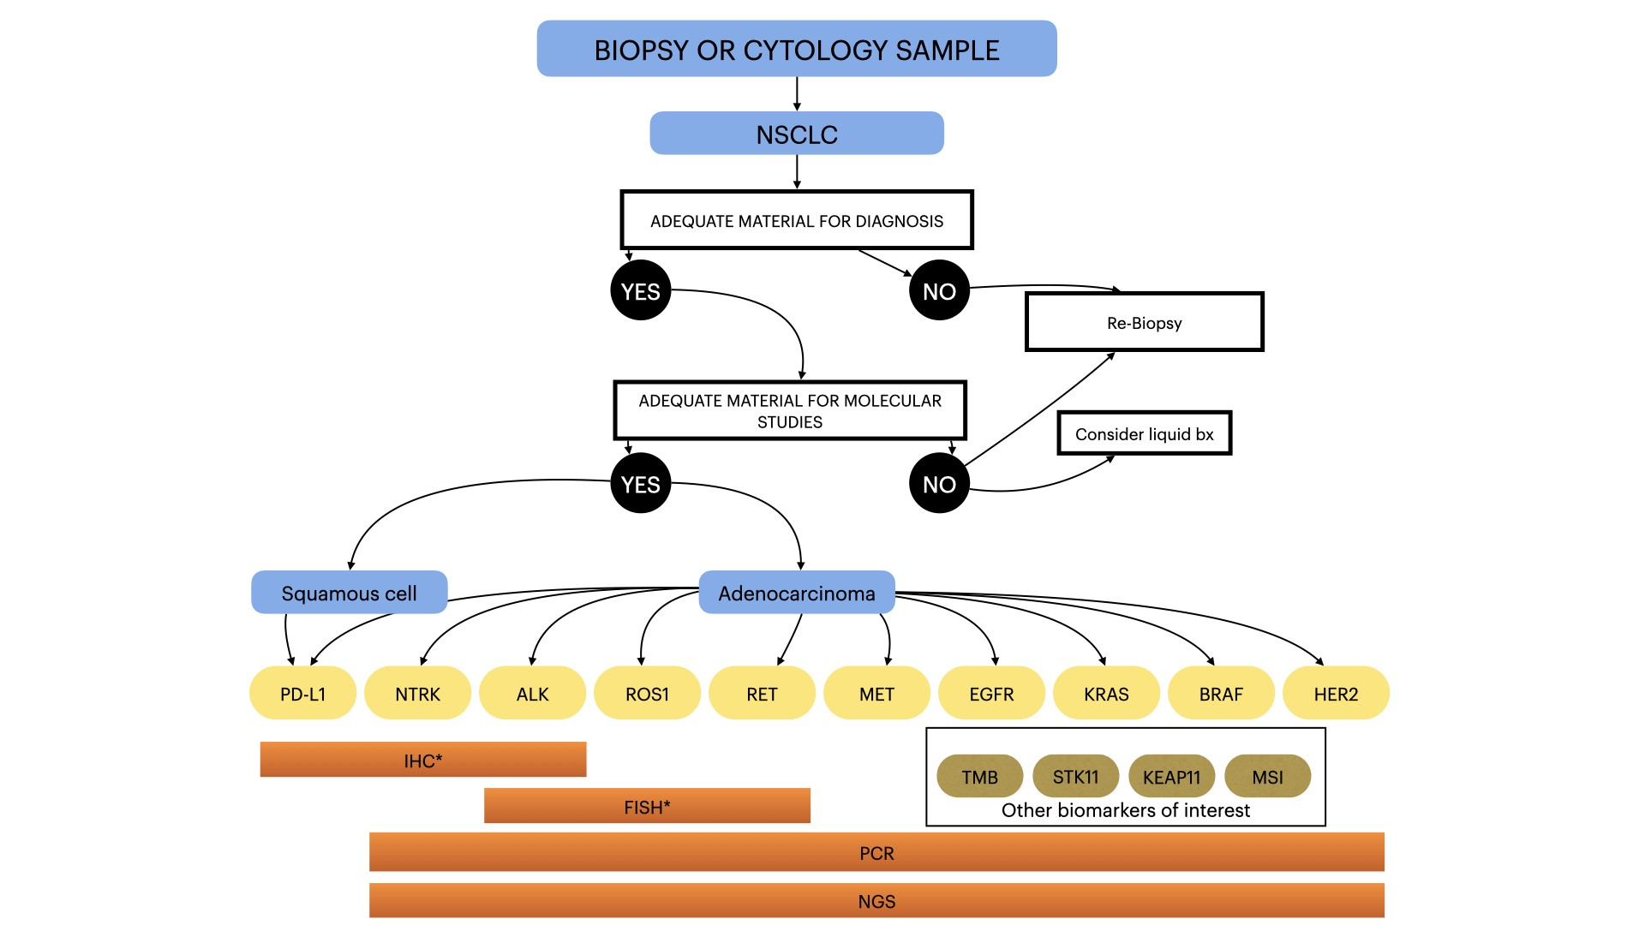
Tavora et al. Surgical and Experimental Pathology. In press.

Slide 13
Her-2
Hiperexpressão proteica, amplificação e mutações (exon 20)
Menos de 2% dos CNPC
Adenocarcinoma, não-fumante e mulheres
PCR, sequenciamento, imuno-histoquímica e FISH
Estratégias de tratamento: TKIs, anticorpos monoclonais e ADCs.
IASLC Atlas of Molecular Testing for Targeted Therapy in Lung Cancer, 2023
Tavora et al. Surgical and Experimental Pathology. In press.
Notes:
Deregulation of the HER2 gene, through protein overexpression, gene amplification, and mutations,
Mutations occur primarily in the intracellular domain within exon 20,
HER2 mutations are detected in less than 2% of all NSCLC and have been primarily associated with adenocarcinoma histology, nonsmoking or never-smoking status, and female sex.
Methods used to assess HER2 alterations vary depending on the alteration type and encompass various polymerase chain reaction (PCR)-based and sequencing techniques (next-generation sequencing [NGS] and non-NGS), immunohistochemistry (IHC), and fluorescence in situ hybridization (FISH).25,31-
Several targeted therapies have shown activity in patients with HER2 mutant tumors. Three dominant treatment strategies have emerged: TKIs, monoclonal antibodies, and antibody-drug conjugates (ADCs; Figure 15-2). HER2 TKIs, including afatinib, dacomitinib, neratinib, and poziotinib, have shown modest activity with consistent toxicity.13,43,44 More promising results have been observed with monoclonal antibodies, such as trastuzumab, in combination with chemotherapy, demonstrating remarkable activity only in retrospective investigations.31,45 Most recently, trastuzumab deruxtecan, a HER2 ADC, was shown to provide durable anticancer activity in patients with previously treated HER2-mutant NSCLC,32 leading to the first drug to be approved by the US Food and Drug Administration (FDA) for treatment of HER2-mutant NSCLC. Efficacy was observed in most patients regardless of HER2 IHC expression or amplification status.

Slide 14
Alterações genéticas coocorrentes tem significante impacto na evolução biológica, resultados clínicos e resposta a tratamento.
As principais comutações associadas ao KRAS estão em TP53, STK11 e KEAP1.
Associados com diferentes propriedades biológicas e sensibilidades terapêuticas (via intrínseca e microambiente).
Níveis de marcadores inflamatórios e moléculas efetoras relacionadas a resposta imune.
Mutações em STK11 e KEAP1 estão relacionadas a pior resposta a imunoterapia.
IASLC Atlas of Molecular Testing for Targeted Therapy in Lung Cancer, 2023
Tavora et al. Surgical and Experimental Pathology. In press.
Notes:
Current data show that co-occurring genetic alterations significantly impact biologic evolution, clinical outcomes, and response to treatments.15,30-34 Large-scale sequencing studies have established a census of major KRAS co-mutations in lung adenocarcinoma.15 Co-occurring mutations in TP53 (~40%), STK11 (ie, serine/threonine kinase 11; 20%), and KEAP1 (ie, Kelch-like ECH-associated protein 1; 13%-24%) are the most frequent.26,30 These 3 subsets are associated with different biologic properties and therapeutic sensitivities15 and could act via intrinsic RAS signaling pathways as well as on the tumor microenvironment. In particular, KRAS/TP53-mutated NSCLC demonstrated increased levels of inflammatory markers and immune checkpoint effector molecules, while KRAS/KEAP1 showed lower levels of immune markers, including programmed death–ligand 1 (PD-L1).15

Slide 15
Marcador emergente: fusão NRG1
Proteína Neuregulin-1 interage com receptores da família ErbB.
0,3% dos CNPC
Não fumantes ou pouco fumantes
Adenocarcinomas mucinosos
7 a 25% dos IMAs KRAS selvagem.
Terapias emergentes: alvo para a via HER2/HER3 desencadeada pela fusão de NRG1, anticorpo biespecífico HER2-HER3 e anticorpo monoclonal HER3.
IASLC Atlas of Molecular Testing for Targeted Therapy in Lung Cancer, 2023
Tavora et al. Surgical and Experimental Pathology. In press.
Notes:
Among non-small cell lung carcinomas (NSCLCs), NRG1 fusions occur with a rate of 0.3%.9 NRG1 fusions occur primarily in light or never-smokers and tumors with the histotype of invasive mucinous adenocarcinomas (IMAs), formerly known as mucinous bronchioloalveolar carcinomas.8,11-13 Among IMAs, NRG1 fusions occur with a frequency of 7%, and they are mutually exclusive with KRAS mutations and other oncogenic drivers. Among KRAS-wild type IMAs, NRG1 fusion frequency is 17% to 25%.
emerging therapeutic options that target the HER2/HER3 pathway triggered by the NRG1 fusion, HER2–HER3 bispecific antibody e HER3 monoclonal antibody

Slide 16
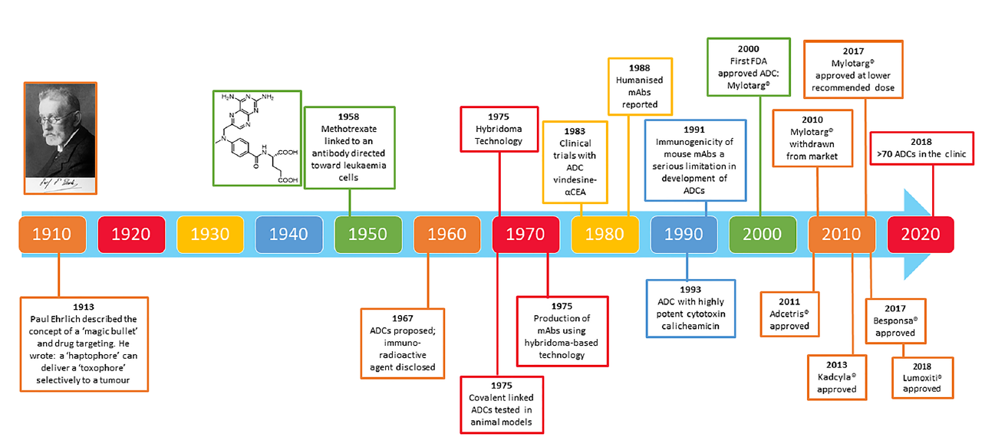
História do desenvolvimento dos ADCs
Pysz I, et al. Cytotoxic Payloads for Antibody-Drug Conjugates. Published by the Royal Society of Chemistry, 2019.
Perez HL, et al. Drug Discovery Today, 2014, 19, 869–881.
Notes:
Poor target antigen selection was the most likely reason for the failure of early ADCs, as exemplified by the KS1/4 antibody–methotrexate conjugate for non-small-
Cell lung cancer and the BR96 antibody–doxorubicin conjugate for metastatic breast cancer. Both ADCs were evaluated in clinical settings but, despite localizing to tumours, provided little or no therapeutic benefit.12 Other factors that may have limited the success of these early ADCs was theiruse of either chimeric or murine antibodies, which elicited immunogenic
responses, and the use of payloads with low cytotoxic potency. The ADC research area has grown rapidly over the past few

Slide 17
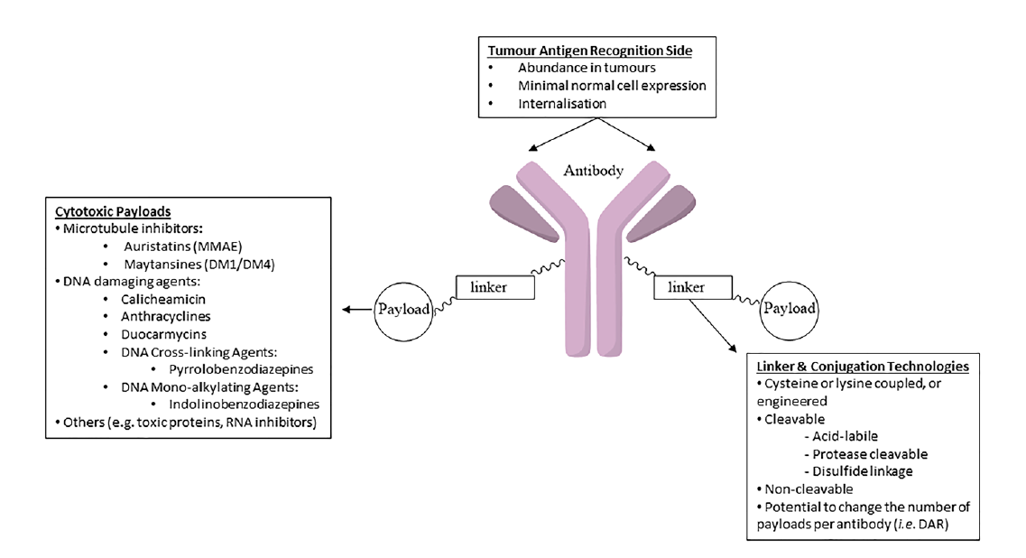
Antibody–Drug Conjugates (ADCs)
ADCs são anticorpos unidos a agentes bioativos através de uma ligação química.
Três componentes:
Anticorpo
Ligante
Carga
Pysz I, et al. Cytotoxic Payloads for Antibody-Drug Conjugates. Published by the Royal Society of Chemistry, 2019.
Jackson PJM, et al. Drug Discovery Today: Technol., 2018, 30, 71–83.
Notes:
ADCs are mAbs attached to biologically active agents through chemical linkers.
These agents target rapidly dividing cancer cells, but at the same time other healthy dividing cells in the body are affected, causing severe side effects and limiting the administrable dose, thus narrowing the therapeutic window. In order to address this issue, one pathway explored by researchers was the development of ADCs, involving the use of antibodies to deliver highly cytotoxic agents directly to tumour cells without affecting other dividing cells in the body. Theoretically, this concept should provide a significant increase in the therapeutic window compared with chemotherapy and radiation. The clinical development of ADCs requires careful development of several biological and pharmaceutical parameters. In particular, there are three key
components to an ADC: the antibody, the linker and the payload

Slide 18
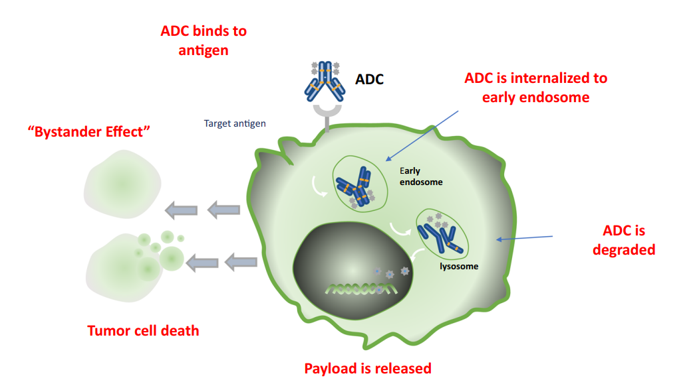
“Bystander Effect”
Expressão homogênea ou heterogênea do antígeno alvo
Droga exportada através da membrana celular
Liberação no extracelular
Potencial terapêutico (matar as células tumorais vizinhas incluindo aquelas sem relevante expressão do antígeno na superfície.
Design do ADC deve considerar seleção da célula alvo, natureza do antígeno, estrutura, estabilidade do anticorpo, propriedades químicas do linker e do payload citotóxico.
Coleman N et al. NPJ Precis. Onc. 7, 5 (2023).
Staudacher AH et al. Br. J. Cancer 2017, 117, 1736–1742.
Verma S et al. Curr Oncol. 2023 Apr 20;30(4):4329-4350.
Notes:
One importante aspect of the mechanism of action of ADCs is the bystander effect by which free drug is exported from the tumour cell through the cell membrane into the tumour environment. This has the potential therapeutic benefit of killing neighbouring tumour cells, including those that may not have the relevant antigen on their surface.12
Another crucial requirement is to ensure that a sufficient concentration of payload reaches the interior of the cancer cells to guarantee their death. In reality, this is a complex process which is difficult to ensure. It has been estimated that, even if the overall mechanism of action of an ADC works at an efficiency of 50%, only 1–2% of the administered payload will reach
the tumour cells.14 Therefore, it is important that the chosen payload is sufficiently cytotoxic to exert an effect at very low concentrations. It is now recognised that the choice of antigen target, and the antibody, linker and payload components, and how effectively they work together, are crucial for the success of an ADC.
Some payloads exert a bystander effect, where the free drug is released unintentionally from the target tumor cell across the cell membrane following internalization and degradation of the ADC, to kill adjacent tumor cells, including those cells that may not express the target antigen on its cell surface. This feature of certain ADCs is often debated and some pharmacological characteristics, such as a hydrophobic payload or a cleavable linker, appear to play a major role in this phenomen5 . When the cytotoxic payload released is permeable or transmembrane, it can also induce the ‘bystander effect’, which can enhance the efficacy of ADC. In addition, the bystander effect of ADCs may also alter the tumor microenvironment, which in turn may further enhance the killing effect of ADCs6 . Moreover, regarding the bystander effect, some chemical properties of the payloads, e.g., lipophilic, hydrophobic, and uncharged payloads are important for the membrane permeability of ADCs, allowing for the distribution from the ADC-targeted tumor cells to non-targeted tumor cells5 . As described above, the linker type, such as the conjugation to the lysine residue, can also result in attenuated bystander effect, as charged residues can promote drug staying within the targeted tumor cell5 . Important considerations in the design of an ADC include target cell selection, the nature of antigen, structure, and stability of the antibody, the linker chemistry, and the cytotoxic payload.

Slide 19

Antibody–Drug Conjugates (ADCs)
Atualmente mais de 100 ADCs em vários estágios de desenvolvimento/trials para diferentes tumores.
Alvos emergentes em NSCLC:
MET, Her2/ERBB2, Her3, TROP-2, CEACAM5, LAG-3, AXL, B7-H3, Mesothelin, Nectin-4, Tissue Factor (TF), Ly6E, FRα, NaPi2b, PTK7...
Antígeno alvo deveria ser altamente expresso na célula tumoral com limitada expressão em tecidos saudáveis.
Anticorpos com alta afinidade pelo antígeno tumoral.
Ligante deve ser estável na circulação e liberar de forma eficiente o agente citotóxico na célula tumoral.
Agente citotóxico altamente potente.
Rosner S et al. Am Soc Clin Oncol Educ Book. 2023 May;43:e389968.

Slide 20
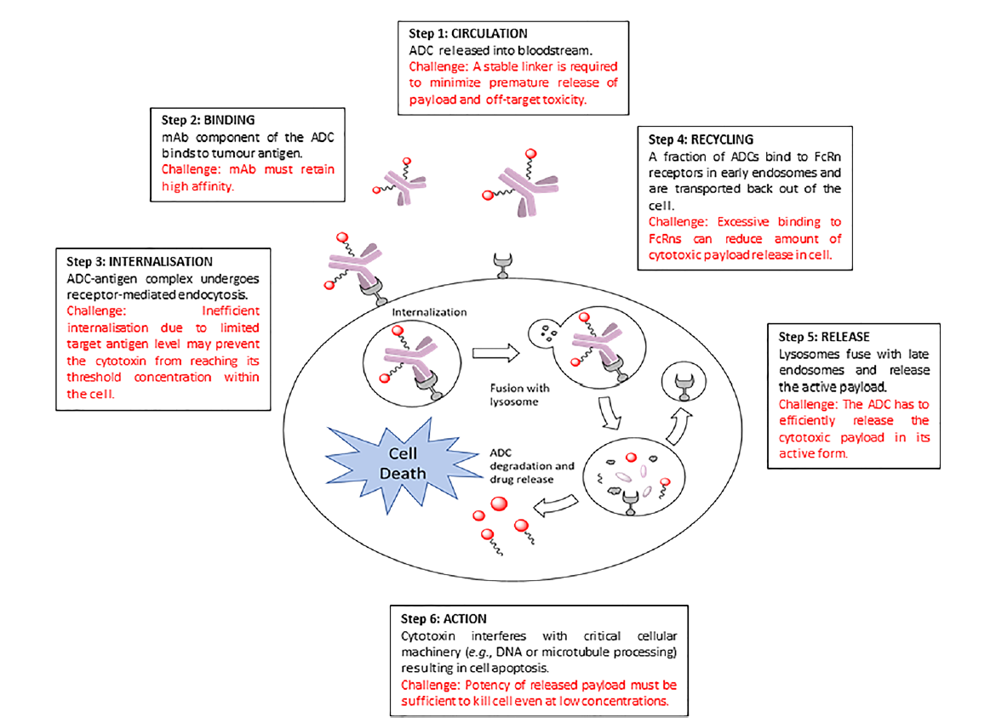
Mecanismo de ação dos ADCs
ADCs se ligam ao antígeno da superfície celular.
Internalização.
Carga citotóxica é liberada após clivagem lisossomal.
Anticorpos reconhecem e se ligam ao antígeno localizado na célula tumoral.
Complexo ADC-antígeno é internalizado por endocitose.
Fusão com o lisossomo.
ADC é degradado e a carga citotóxica é liberada levando a morte celular.
C. Peters and S. Brown, Biosci. Rep., 2015, 35, e00225.
Pysz I, et al. Cytotoxic Payloads for Antibody-Drug Conjugates. Published by the Royal Society of Chemistry, 2019.
Notes:
ADCs are mAbs attached to biologically active agents (payloads) by chemical linkers (Figure 1.6). An ADC binds to an antigen on the surface of a cancer cell and then internalises, after which the highly cytotoxic payload molecule is released, typically by lysosomal cleavage.
ADCs are designed to directly target and kill cancer cells, and so the antibody has to be able to recognise and bind to its corresponding antigen localized on the tumour cell. Once bound to the antigen, the entire antigen–ADC complex is then internalized through receptor-mediated endocytosis. The internalization process proceeds with the formation of a clathrin-coated
early endosome containing the ADC–antigen complex. Once inside the lysosome, the ADC is degraded and free cytotoxic payload released into the cell, leading to cell death

Slide 21
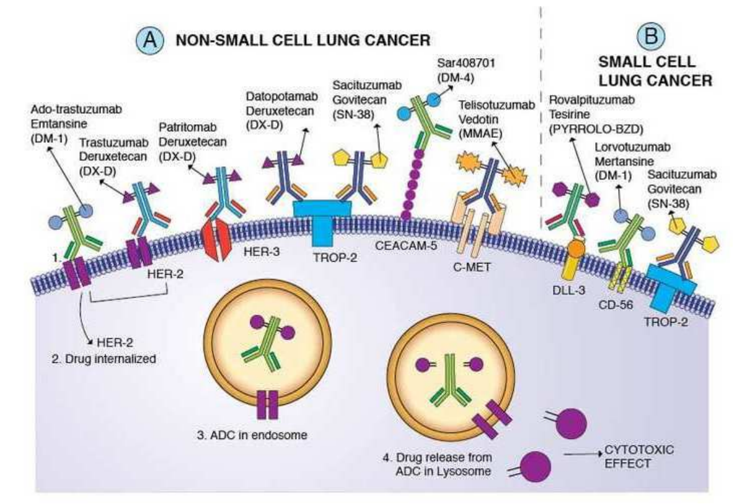
Desai A, et al. Lung Cancer. 2022;163:96-106.

Slide 22
Trop-2 (Trophoblast cell-surface antigen 2)
Glicoproteína transmembrana transdutora de sinal de cálcio.
Media a migração celular e crescimento.
Hiperexpressão observada em até 64% dos adenocarcinomas pulmonares e 75% dos carcinomas de células escamosas.
Associada a pior sobrevida global e sobrevida livre de doença em vários tumores sólidos.
Pode ter um papel na resistência a QT e apoptose de células T CD8.
Coleman N et al. NPJ Precis. Onc. 7, 5 (2023).
Rosner S et al. Am Soc Clin Oncol Educ Book. 2023 May;43:e389968.
Notes:
rop-2 é uma glicoproteína transmembrana transdutora de sinal de cálcioTrophoblast cell-surface antigen 2 (TROP-2) is a glycoprotein transmembrane calcium signal transducer present in more than 50% of lung adenocarcinoma and squamous cell carcinoma, associated with poor survival.

Slide 23

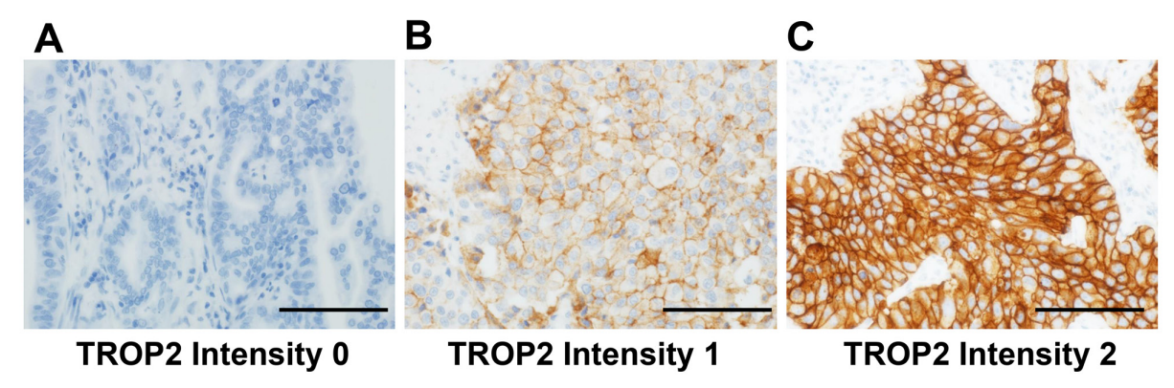
*Alta expressão de TROP2 (Intensidade 1 ≥ 50% ou Intensidade 2 ≥ 10%)
18%
21/115
64%
172/270
75%
150/201
Notes:
Intriguingly, the association of TROP2 expression with mortality was dependent on the lung cancer subtype. High TROP2 expression was associated with higher lung cancerspecific mortality in adenocarcinomas [univariable hazard ratio (HR) = 1.60, 95% confidence interval (CI) = 1.07–2.44, P = 0.022)], but not in SqCCs (univariable HR = 0.79, 95% CI = 0.35–1.94, P = 0.79). In HGNETs, high TROP2 expression was associated with lower lung cancer-specific mortality in both univariable and multivariable analyses (multivariable HR = 0.13, 95% CI = 0.020–0.44, P = 0.0003). Our results suggest a differential role for TROP2 in different lung cancer subtypes.

Slide 24
Proteína transmembrana codificada pelo gene do receptor erb-b2 tirosina quinase 2.
Alterações em HER2 em NSCLC é descrita em três mecanismos: 1) mutação; 2) ganho no número de cópias/ampliacação; 3) hiperexpressão.
Mutações são tipicamente inserções in frame no exon 20 (96%)
Ocorre em 1 a 4% dos NSCLC.
Mais frequente em nunca fumantes e adenocarcinoma.
Amplificação: 2 a 5% dos NSCLC.
Hiperexpressão proteica: 10 a 30% dos NSCLC (frequencia específica depende do cutoff usado).
Correlação com pior sobrevida.
Destiny-Lung01 fase 2 avaliou duas cohorts de NSCLC: Her2 hiperexpresso e Her2 mutado. Robusta atividade na cohort Her2 mutada.
HER2 (Human epidermal growth factor receptor 2)
Coleman N et al. NPJ Precis. Onc. 7, 5 (2023).
Rosner S et al. Am Soc Clin Oncol Educ Book. 2023 May;43:e389968.
Li BT et al. N Engl J Med 386:241-251, 2022.
Merle G et al. Cancer J. 2022 Nov-Dec 01;28(6):429-435.
Notes:
Interim analysis of the HER2-overexpressing cohort (overexpressing HER2 centrally confirmed, IHC 2+ or 3+) has shown preliminary evidence of antitumor activity in 49 heavily pre-treated patients with HER2-overexpressing NSCLC. Patients with stable brain metastases were included, 34.7% had CNS metastases at enrollment; 79.6% of patients had HER2 IHC 2+ and 20.4% had HER2 IHC 3+. Confirmed overall response rate (ORR) by ICR was 24.5% (95% CI, 13.3%–38.9%), including one complete response (CR). Response rates varied based on the expression of HER2: ORR for patients with IHC overexpression of 3+ was 20.0% (95% CI, 2.5%–55.6%) and 25.6% for IHC 2+ (95% CI, 13.0%–42.1%); IHC 3+, median DOR was 6.0 months (95% CI, 3.2-NE months). Disease control rate (DCR) was 69.4% (95% CI, 54.6%–81.8%); estimated median PFS was 5.4 months (95% CI, 2.8–7.0 months). Even more impressive responses were produced in the HER2-mutant NSCLC cohort of the DESTINY-Lung01 (NCT03505710) trial⁵¹. Confirmed objective response occurred in 55% of the patients (95% CI, 44–65), with one CR, stable disease (SD) ≥ 6 weeks in 34 patients (37%), DCR 92%. Responses observed were diverse, demonstrated in patients with both different HER2 mutation subtypes and across exon locations; in addition, responses were observed in patients with no detectable HER2 expression and in patients with no HER2 amplification. Median PFS was 8.2 months (95% CI = 6.0–11.9 months) and median OS was 17.8 months (95% CI = 13.8–22.1 months)⁵¹.

Slide 25
HER3 (Human epidermal growth factor receptor 3)
Membro da família de proteínas quinase ErbB/HER
HER3 por si só não é uma oncoproteína (perde a atividade quinase)
Heterodimeriza com outros receptores tirosina quinase incluindo membros da família HER e MET resultando em ativação de vias oncogênicas (PI3K/AKT/mTOR e também sinalização MEK/MAPK, Jak/Stat, Src quinase) – proliferação celular, sobrevida e progressão.
HER3 expressão também pode mediar resistência a terapia alvo (EGFR-TKI – HER3 media ativação da sinalização PI3K/AKT)
Presente em vários tumores sólidos e relatado em até 83% dos NSCLC.
Relacionado a progressão e menor sobrevida livre de doença.
Patritumab deruxtecan:
bystander killing effect (afeta o alvo e células adjacentes).
Em estudo em pacientes com EGFR metastático ou localmente avançado com tratamento prévio com EGFR TKI e QT.
Coleman N et al. NPJ Precis. Onc. 7, 5 (2023).
Rosner S et al. Am Soc Clin Oncol Educ Book. 2023 May;43:e389968.
Notes:
Patritumab deruxtecan. Patritumab deruxtecan (U3-1402, HER3- DXd) is a novel HER3-directed ADC composed of a human immunoglobulin G1 monoclonal antibody to HER3 (patritumab) which is linked covalently to a topoisomerase I inhibitor payload (MAAA-1181a, an exatecan derivative) via a stable tetrapeptidebased cleavable linker with a high DAR ratio at 458,59. The payload is highly potent with a short systemic half-life, and the cell membrane is permeable, which allows for a bystander killing effect, affecting both target and surrounding tumor cells60. Based on promising pre-clinical data, which demonstrated antitumor activity of HER3-DXd in multiple solid tumor xenograft models61, a phase I study was initiated in patients with locally advanced or metastatic EGFR-driven NSCLC with prior treatment with EGFR TKI and platinum-based chemotherapy (NCT03260491), which ultimately led to FDA breakthrough therapy designation (BTD) in December 2021.

Slide 26
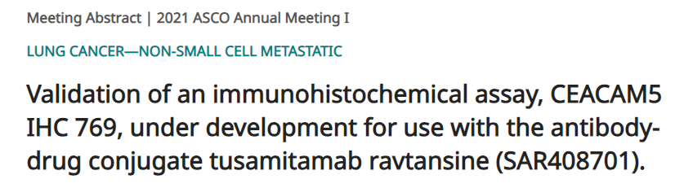
CEACAM5 (Carcinoembryonic antigen-related cell adhesion molecular 5)
CEACAM5 é uma família de glicoproteínas de superfície celular implicadas em adesão e sinalização.
Promovem proliferação celular e migração consequentemente progressão e metástases.
CEACAM IHC 769 para detecção da proteína CEACAM5 em tecido fixado em formalina (FFPE) (Murine anti-CEACAM5 clone 769).
EnVision Flex visualization system (Dako).
Escore:
marcação parcial ou completa da membrana plasmática tumoral com intensidade ≥2+
Coloração linear ou pontilhada.
Marcação completa ou parcial envolvento membrana basal, lateral ou basolateral ou apical.
Cutoff de ≥50% com intensidade ≥2+.
Conclusão:
Validação interna demonstrou que CEACAM5 IHQ 769 é sensível, específico, preciso, reprodutível e robusto na avaliação de expressão de CEACAM5 em espécimes de NSCLC no cutoff de ≥50% e intensidade ≥2+.
Lefebvre AM et al. Lung Cancer. 2023 Oct;184:107356.
LaPointe N et al. J Clin Oncol. 2021;39(suppl 15):e21030.
Notes:
Carcinoembryonic antigen-related cell adhesion molecular 5.
Carcinoembryonic antigen-related cell adhesion molecular 5 (CEACAM5) is a glycoprotein member of the CEA gene family and seems to promote cell proliferation and migration

Slide 27
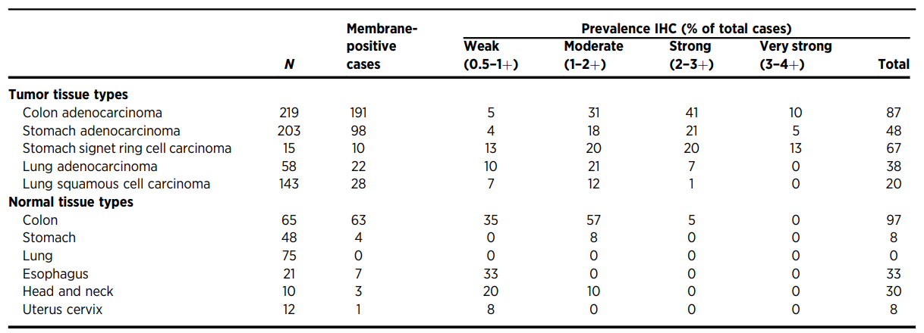
Prevalência de CEACAM5 em tumores e tecido normal
82% dos adenocarcinomas de cólon (forte a moderada)
44% dos adenocarcinomas de estômago (forte a moderada)
53% dos carcinomas em anel de sinete do estômago (forte a moderada)
28% dos adenocarcinomas pulmonares (forte a moderada)
13% dos CEC pulmonares (forte a moderada)
Expressão não foi detectada no pulmão normal
Alta prevalência de expressão em amostras de cólon normal (predomínio de fraca a moderada)
Decary S et al. Clin Cancer Res. 2020 Dec 15;26(24):6589-6599.
Notes:
Identification of CEACAM5 expression was based on staining in the membrane of tumor cells. Tumor cell membrane CEACAM5 expression was observed in 87% (191/219) of colon adenocarcinoma cases with very strong-to-moderate staining intensity in 82% of total cases. Membrane CEACAM5 expression was also observed in 48% (98/203) of stomach adenocarcinoma (very strong-tomoderate staining intensity in 44% of total cases), 67% (10/15) of stomach signet ring cell carcinoma (very strong-to-moderate staining intensity in 53% of total cases), 38% (22/58) of lung adenocarcinoma (strong-to-moderate staining intensity in 28% of total cases), and finally 20% (28/143) of lung squamous cell carcinoma (strong-to-moderate staining intensity in 13% of total cases; Table 1). CEACAM5 expression was detected in normal tissue from the colon, esophagus, head and neck, stomach, and uterus cervix. No CEACAM5 expression was detected in normal lung tissue (Table 1). The highest prevalence of membrane CEACAM5 expression was observed in normal colon samples [97% (63/65)], but this was predominantly with a weak-to-moderate staining intensity (92% of total cases) and restricted to the apical border of differentiated columnar absorptive epithelial cells in the upper epithelial layer (Table 1). Less prevalent expression of CEACAM5 was observed in normal esophageal tissue at the membrane of cells of the intermediate and upper layers of the esophageal epithelium [33% (7/ 21)], and for the head and neck, in the membrane of epithelial cells of the larynx mucosae [30% (3/10; Table 1]. Sporadic expression of CEACAM5 was also observed in normal stomach tissues, in the apical border of epithelial cells in the upper layer of the gastric pit [8% (4/48)] and in one normal uterus cervix sample in the membrane of epithelial cells [1/12 (8%)]; no expression was observed in normal lung tissue; including parenchyma or bronchus (Table 1).

Slide 28
Alteração | Método de detecção
MET exon 14 Skipping (3 a 4% NSCLC) | NGS e sequenciamento RNA
Amplificação (1 a 6% NSCLC) | NGS e FISH
Hiperexpressão protéica (varia de 20 a 80% em cohorts) | IHQ
C-MET (Mesenchymal epitelial transition receptor)
Receptor Tirosina quinase
Após ligação com HGF (fator de crescimento do hepatócito) ativa diferentes vias de sinalização celular incluindo aquelas envolvidas em proliferação, motilidade, migração e invasão.
Ativado de forma aberrante em câncer via mutação, amplificação e hiperexpressão protéica.
Organ SL, Tsao MS. Ther Adv Med Oncol. 2011 Nov;3(1 Suppl):S7-S19.
Champagnac A et al. J Thorac Dis. 2020 May;12(5):2172-2178.
Notes:
c-MET is a receptor tyrosine kinase that, after binding with its ligand, hepatocyte growth factor, activates a wide range of different cellular signaling pathways, including those involved in proliferation, motility, migration and invasion. Although c-MET is important in the control of tissue homeostasis under normal physiological conditions, it has also been found to be aberrantly activated in human cancers via mutation, amplification or protein overexpression.
Amplificação pode ser mecanismo de resistência a EGFR.

Slide 29
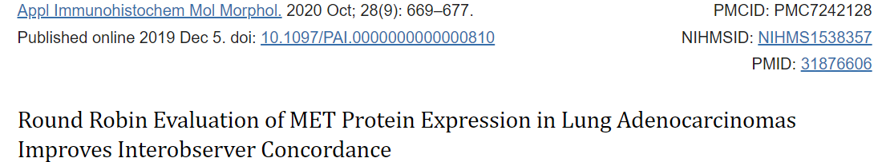
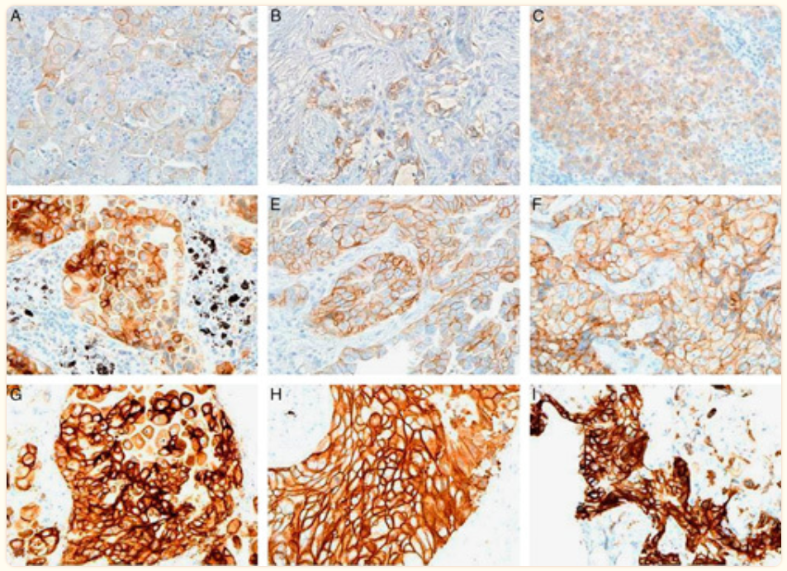
Avaliação do escore do MET: melhor desempenho após treinamento e comunicação entre patologistas.
Coeficiente de correlação melhorou de 0.50 (95% CI:0.37-0.64) do primeiro escore “round” para 0.74 (95% CI:0.64-0.83) no segundo.
Importante:
Hiperexpressão proteica de MET ocorre independentemente de mutações ou amplificação subjacentes.
Atenção aos controles de reação.
Boyle TA et al. Appl Immunohistochem Mol Morphol. 2020 Oct;28(9):669-677.
Notes:
MET protein over expression is independent of underlying mutation or amplification—no orthogonal method to confirm staining accuracy • MET is an example but this is true for any potential target where protein overexpression is independent of underlying mutation or amplification
Evaluation of MET staining and scoring has suffered from poor interobserver variability • Lung Cancer Mutation Consortium Pathologist Panel initiated “Round Robin” conferences with the goal of standardizing the evaluation of MET protein expression • Intraclass correlation coefficient comparing consistency of scoring improved from 0.50 (95% CI: 0.37-0.64) for the first scoring round to 0.74 (95% CI: 0.64-0.83) for the second round

Slide 30
Biomarcadores para selecionar pacientes com NSCLC para ADCs em investigação (clinical trials)
Biomarcador | Droga | Critérios
HER2 | Traztuzumab deruxtecan | HER2 mutado HER2 hiperexpresso (IHQ ≥2+ intensidade)
HER3 | Patritumab deruxtecan | Mutação para EGFR (falha em TKI) 2ªL com ou sem outro oncogene driver
c-MET | Telisotuzumab vedotin | NSCLC – não escamoso: C-MET alto expressor = IHQ 3+ (intensidade) em ≥50%TCs C-MET expressão intermediária = IHQ 3+ intensidade em ≥25% a 50% TCs NSCLC – escamoso: C-MET positivo = IHQ 1+ intensidade em ≥75% TCs
TROP2 | Datopotamab deruxtecan Sacituzumab gevitecan | Sem marcador
CEACAM5 | Tusamitamab ravtansine | CEACAM5 alta expressão = IHQ ≥ 2+ intensidade em ≥ 50% TCs CEACAM5 moderada expressão = IHQ ≥ 2+ intensidade em 1-49% TCs
Camidge DR et al. J Thorac Oncol. 2021. Abstract. Vol 16. Issue 10. Page S875.
Li BT et al. N Engl J Med. 2022 Jan 20;386(3):241-251.
Nakagawa K et al. Presented at: 2020 World Conference on Lung Cancer Singapore; January 28-31; Virtual. Abstract OA04.05

Slide 31

Biomarcadores para imunoterapia em câncer de pulmão
PD-L1: biomarcador preditivo para imunoterapia
TMB, Neoantígenos, assinaturas genéticas e epigenéticas
Microambiente imune tumoral
Assinaturas transcriptômicas
Novas tecnologias para avaliação de TME
Microbioma
Mino-Kenudson M et al. J Thorac Oncol. 2022 Dec;17(12):1335-1354.
Notes:
Given the limitations of TMB as a single predictive biomarker, there has been, for two main reasons,39 renewed interest in the study of neoantigens, that is, mutated peptides originating from somatic mutations generating antitumor T-cell responses when presented by MHC proteins.40 First, the quantity and quality of the neoantigen response may improve the prediction of ICI treatments41–45 whereas loss of neoantigens is a mechanism of immune escape and ICI resistance, particularly in lung squamous cell carcinoma.46,47 Second, neoantigen-based vaccines and adoptive T-cell therapies are being developed.40 Because there is no standardized method for neoantigen identification, current methods rely on bioinformatic pipelines (HLA typing, inference of neopeptides, MHC-binding prediction, and candidate neoantigen selection).40,48 In NSCLC, the median number of neoantigens per tumor has been predicted to be between 63 and 214.40 Not surprisingly, higher numbers are associated with high PD-L1 expression and smoking-related genomic signatures.

Slide 32
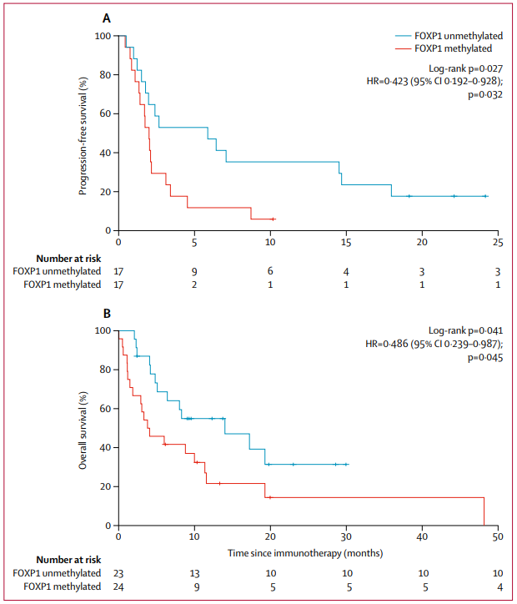
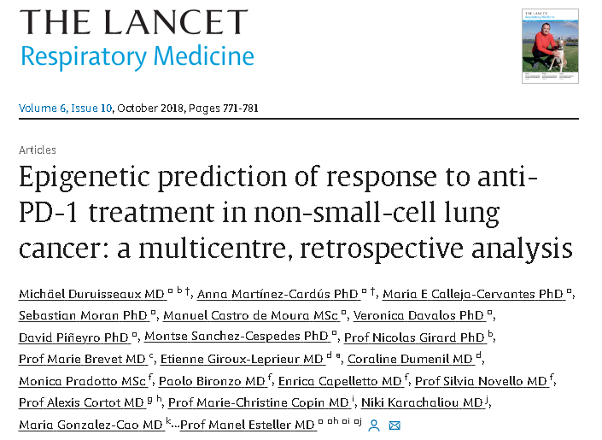
Mecanismos epigenéticos podem afetar a resposta a inibidores de imunocheckpoint principalmente através da metilação de promotores de genes que codificam checkpoints imunes ou antígenos associados ao tumor o que dificulta a apresentação de antígenos, migração de células T e secreção de citocinas.
Entre os sítios de CpG estudados, foram encontrados 301 sítios com nível de metilação significantemente associado a resposta clínica ao bloqueio de PD-1 em NSCLC.
O status de metilação nesses sítios (EPIMMUNE assinatura epigenética) foi significantemente associada sobrevida livre de progressão e sobrevida global.
Duruisseaux M et al. Lancet Respir Med. 2018; 6: 771-781.
Notes:
Among the CpG sites studied, we found 301 CpG sites (<1%) at which the methylation levels were significantly associated with clinical response to PD-1 blockade in NSCLC (false discovery rate adjusted p<0・05 for all sites). The characteristics of these 301 CpG sites are described in detail in the appendix. The methylation status of these sites, hereafter referred to as the EPIMMUNE epigenetic signature, was significantly associated with progression free survival and overall survival (figure 1).

Slide 33
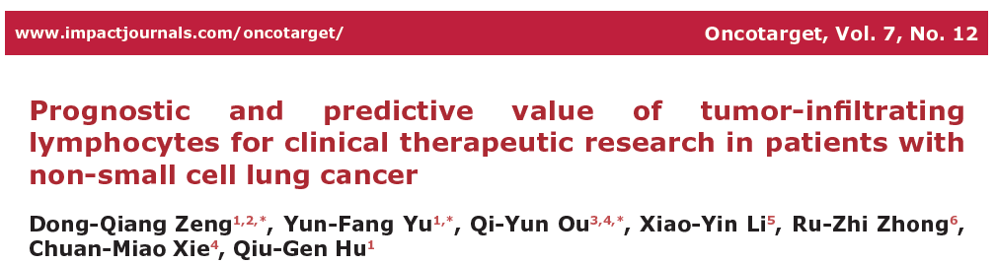
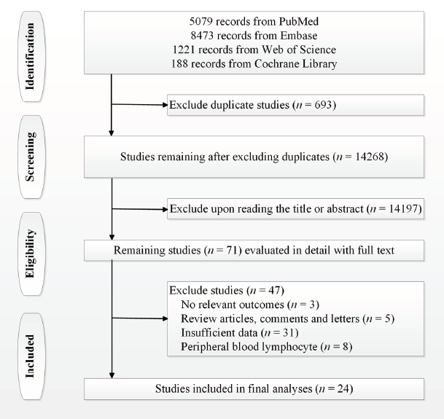
Níveis elevados de TILs CD8+ são bom prognóstico em relação a sobrevida global (p=0,013), “disease-specific survival” (p=0,004) e sobrevida livre de doença ou recorrência (p=0,001)
Níveis elevados de linfócitos T CD3+ tem bom prognóstico em relação a sobrevida global (p=0,009) e “disease-specific survival” (p=0,001)
Níveis elevados de linfócitos T CD4+ tem bom prognóstico em relação a sobrevida global (p=0,005)
Altos níveis de Tregs FoxP3+ tem pior prognóstico em relação a sobrevida global e sobrevida livre de recorrência (p=0,042 e p=0,001)
Zeng DQ, et al. Oncotarget. 2016;7(12):13765-81

Slide 34
Desafios
Método semiquantitativo
Diferentes “cut-offs” são utilizados para definir infiltração “leve” e “acentuada”
Definição de compartimento (blocos tumorais ou estroma tumoral)
Contagem absoluta (análise digital de imagem ou contagem manual)
Estudos retrospectivos
Avaliação padronizada dos “TILs”
Inclusão de folículos linfóides
Remark R, et al. Am J Respir Crit Care Med. 2015;191(4):377-390
Notes:
Ativação de moléculas para recrutamento de linfócitos T, impacto no microambiente imune. Alta densidade associada a alto número de células T CD8 de memória

Slide 35
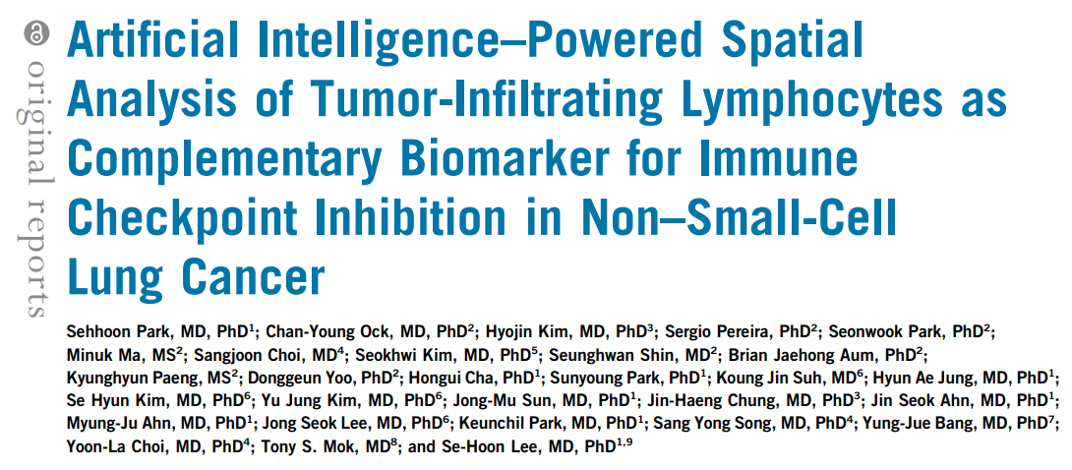
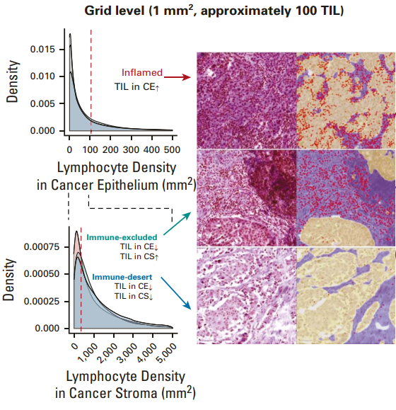
Em teoria, TILs são o principal ativador da imunidade antitumoral e poderia ser um biomarcador promissor se avaliado objetivamente no microambiente tumoral.
Conceito de imunofenótipo é baseado no status de TILs no microambiente:
Inflamado
Exclusão imune (TIL excluído do estroma tumoral).
Deserto imune (TIL escasso no microambiente).
*padronização da metodologia para classificação.
*heterogeneidade interobservador.
Metodologia:
Inteligência artificial (AI): spatial TIL analyser (Lunit SCOPE IO)
Distribuição heterogênea dos TILs (tumor infiltrating lymphocytes) nas lâminas em diferentes aumentos:
Grids de 1mm ² e cada grid foi mensurado.
Limiares foram estabelecidos tanto no componente epitelial quanto no estromal para definição dos subgrupos (inflamado, exclusão imune e deserto imune).
Park S et al. J Clin Oncol. 2022 Jun 10;40(17):1916-1928.
Notes:
In theory, tumorinfiltrating lymphocytes (TIL) are the main activator of antitumor immunity and could be a promising biomarker if TIL can be objectively assessed throughout the whole tumor microenvironment (TME).
To analyze spatial analysis of heterogeneous TIL distribution in WSI with various sizes, WSI were divided into 1 mm2 - sized grids and the IP of each grid classified on the basis of the proportion of each component. IP was defined as follows13,14: inflamed as TIL density in CE area above the threshold (106/mm2 ); immune-excluded as TIL density in CE area below the threshold and TIL density in CS area above the threshold (357/mm2 ); and immune-desert as both TIL density in CE area and that in CS area below the thresholds. Inflamed score, immune-excluded score, and immune-desert score of WSI were defined by the number of grids annotated to certain IP divided by total analyzed grids in WSI. We have developed an artificial intelligence (AI)–powered spatial TIL analyzer (Lunit SCOPE IO) that is capable of segmentation and quantification of multiple histologic components from hematoxylin and eosin (H&E)–stained WSI.15,16 We hypothesize that objective classification of IP by Lunit SCOPE IO is an efficacious biomarker for prediction of tumor response to ICI in patients with advanced NSCLC.

Slide 36
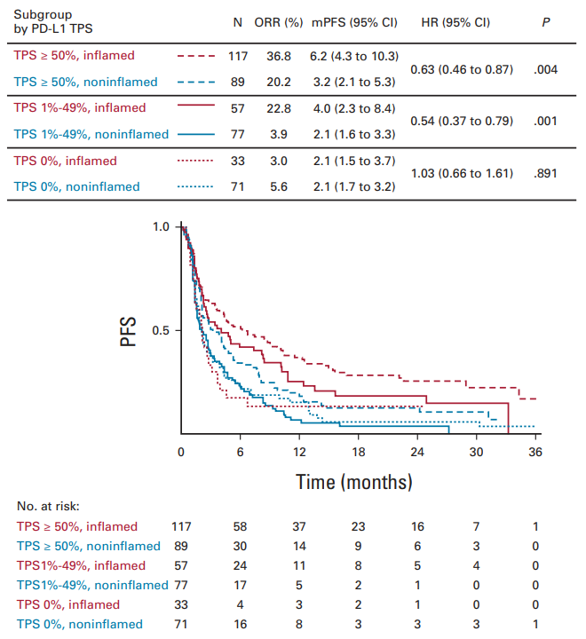
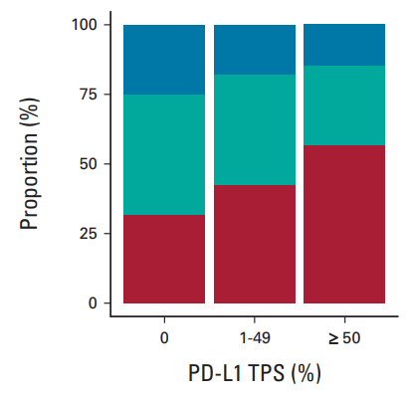
NSCLC avançado, multicêntrico, n=518
Pacientes tratados com imunoterapia (ICI monoterapia):
Imunofenótipo inflamado se correlaciona com maior taxa de reposta tumoral e maior sobrevida livre de progressão.
PFS: inflamado > exclusão ou deserto immune
PFS de QT: sem diferença
Relação entre imunofenótipo e TPS:
Incidência de inflamado IP foi de 56,8% para TPS≥50%
Incidência de deserto imune IP foi mais comum no grupo PD-L1 1% (25%)
Boa correlação status do TPS e imunofenótipo inflamado.
Park S et al. J Clin Oncol. 2022 Jun 10;40(17):1916-1928.

Slide 37
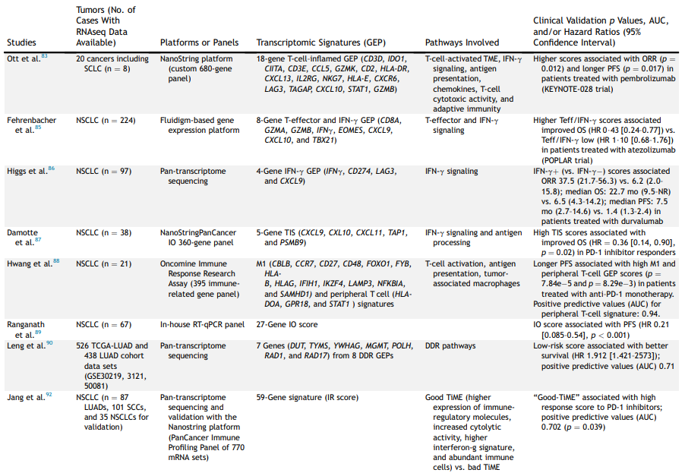
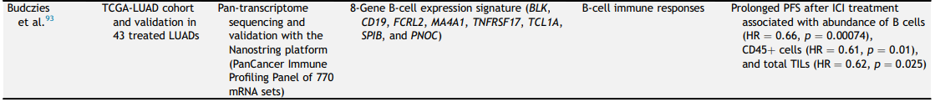
Principais assinaturas transcriptômicas para predizer resposta ou resistência a ICIs em NSCLC
As assinaturas transcriptômicas preditivas consideram um grupo de genes envolvidos na antigenicidade tumoral e ativação de células T: interação com células dendríticas ativadas, genes relacionados a infiltração de células T para o tumor, ao reconhecimento de células cancerígenas pela célula T, a infiltração por células inibitórias e genes que codificam ligantes ou receptores associados a imunocheckpoints.
Mino-Kenudson M et al. J Thorac Oncol. 2022 Dec;17(12):1335-1354.

Slide 38
Microbioma é uma coleção dinâmica de organismos comensais que colonizam sítios do corpo humano e tem sido relacionados a reposta a imunoterapia e impacto na imunidade anticâncer.
Provém proteção a organismos patogênicos e regula imunidade (o sistema imune é estimulado pela microbioma que regula a resposta inflamatória local e ajuda a resposta imune adaptativa).
Alteração na composição do microbioma pode afetar o microambiente imune tumoral pelo retorno/recirculação de linfócitos.
Análise da composição do microbioma intestinal seria favorável para prever o efeito da terapia com anti-PD-1/PD-L1.
O exato mecanismo pelo qual o microbioma alterado afeta a reposta a imunoterapia ainda não é claro.
Microbioma
Mino-Kenudson M et al. J Thorac Oncol. 2022 Dec;17(12):1335-1354.

Slide 39
Exemplos:
Sivan A et al observou que transplante de microbioma fecal poderia restaurar a sensibilidade a tratamento anti-PD-L1 e melhorar a atividade anti-tumoral em ratos não-respondedores.
Gopalakrishnan V et al notaram relação entre alta abundância de Faecalibacterium genus e eleva taxa de resposta em pacientes que receberam tratamento anti-PD-1.
Disbiose causada pela utilização de antibióticos parece influenciar a eficácia de terapia anti-PD-1/PD-L1. E a pouca resposta aos agentes poderia ser revertida pela recolonização com Akkermansia muciniphila (Routy B et al, 2018).
Melhor compreensão do eixo câncer-microbioma-resposta imune
Método ótimo para avaliação do microbioma intestinal e/ou respiratório ainda não foi determinado.
Impacto de fatores intrínsecos e extrínsecos como raça, dieta, tabagismo, antibióticos e outras exposições ambientais é ainda pouco compreendido.
Microbioma poderia ser um biomarcador clinicamente útil?
Sivan A et al. Science. 2015;350:1084-1089.
Gopalakrishnan V et al. Science. 2018;359:97-103.
Routy B et al. Science. 2018;359:91-97.
Yi M et al. Mol Cancer. 2018;17:129.
Mino-Kenudson M et al. J Thorac Oncol. 2022 Dec;17(12):1335-1354.
Notes:
Nevertheless, the optimal method of evaluating the gut (or respiratory) microbiome has not been determined, and the potential impact of intrinsic and extrinsic factors such as race, diet, smoking, antibiotics, or other environmental exposures is poorly understood.
cancer-microbiome-immune axisthe microbiome could be a clinically useful biomarker.

Slide 40
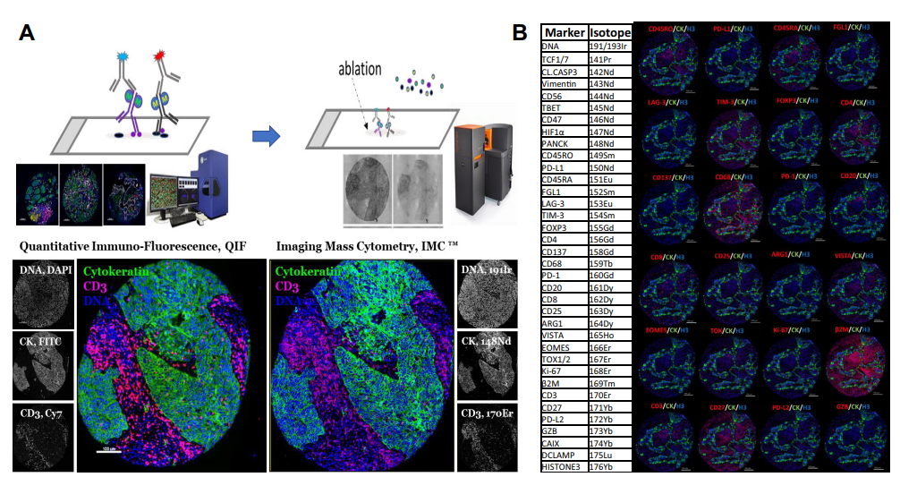

Novas Tecnologias
Biópsia líquida (DNA tumoral circulante – ctDNA)
Análise tecidual multiplex
AI
Forte associação entre redução do níveis de ctDNA e melhor sobrevida global. Além disso, redução em ctDNA também foi associada a melhor resposta tumoral (RECIST).
ctDNA pode servir com um indicador precoce de benefício do tratamento.
Mino-Kenudson M et al. J Thorac Oncol. 2022 Dec;17(12):1335-1354.
Vega DM et al. JCO Precis Oncol. 2022 Aug;6:e2100372.
Notes:
Given the plethora of immune-cell markers and cytokines involved in prediction of response or resistance to ICIs, multiplexed platforms have been widely used to simultaneously evaluate those predictive markers and determine the activation or dysfunction status of effector T cells, “driver” immune-inhibitory pathways, and extent of immune-inhibitory populations in the TME.
. (A) Representative images revealing a human FFPE NSCLC sample stained with multiplex immunofluorescence using DAPI, AE1-AE3 panCK, and CD3 with metal-conjugated antibodies (left panels) and subsequently analyzed using imaging mass cytometry (right panels). (B) Representative images from NSCLC stained simultaneously with a 37-marker IMC panel including tumor- and immune-cell markers. Selected markers are indicated within each caption. Bar ¼ 100 mm. DAPI, 40 ,6-diamidino-2- phenylindole; FFPE, formalin-fixed, paraffin-embedded; IMC, imaging mass cytometry; panCK, pancytokeratin.

Slide 41

obrigadA!
ellen.nascimento@hc.fm.usp.br

